Slide 1

Problem Solving Using Computer
Course Code: BCAC 0018
Lecture – 7, 8 & 9
Course: BCA I Year I Semester
By: Mr. Shivank Chauhan
shivank.chauhan@gla.ac.in
+91-9694159338

Slide 2
Components of a Digital Computer
A computer is a programmable machine. The two main characteristics of a computer are:
(i) It responds to a specific set of instructions in a well-defined manner.
(ii) It can execute a pre-recorded list of instructions (a program).
Modern computers are electronic and digital.
The actual machinery - wires, transistors and circuits is called hardware;
The instructions and data are called software.

Slide 3
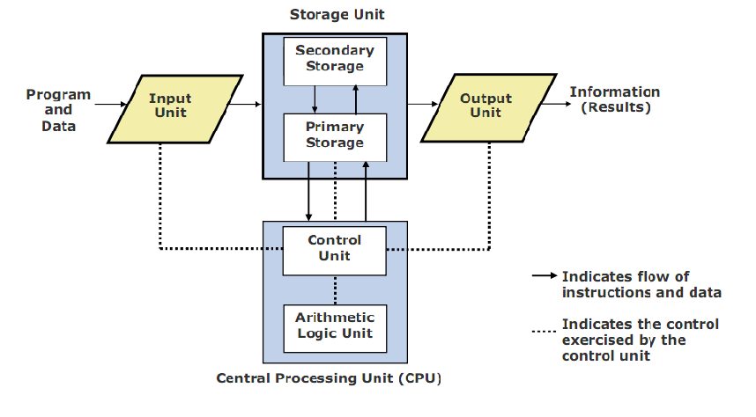
Basic units of computer

Slide 4
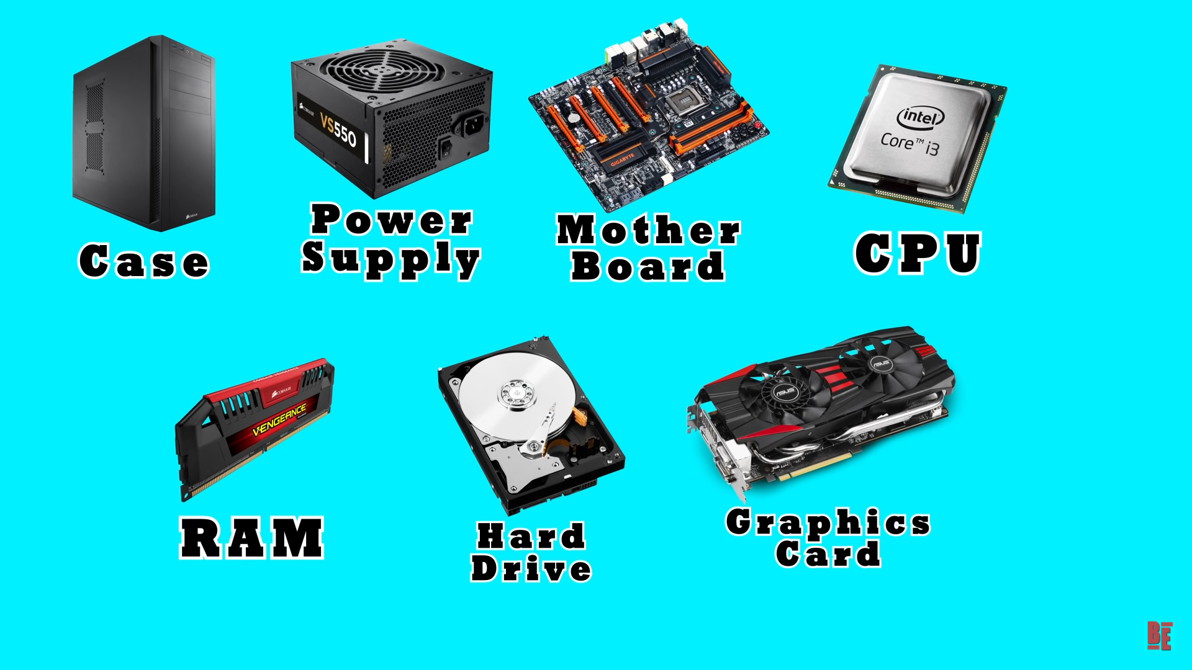
Main components of a Computer System

Slide 5
1. Central Processing Unit (CPU)
Executes program instructions
The CPU is based on a single electronic component, the microprocessor chip, within the system unit or system cabinet.
The system unit also includes circuit boards, memory chips, and other components.
The CPU has two parts -The Control Unit (CU) and the Arithmetic Logic Unit (ALU).
In a microcomputer, both are on a single microprocessor chip.

Slide 6
a. Control Unit (CU)
The control unit tells the rest of the computer system how to carry out a program’s instructions.
It directs the movement of electronic signals between memory and the ALU.
It also directs these control signals between the CPU and input/output devices.

Slide 7
b. Arithmetic - Logic Unit (ALU)
Arithmetic Logic Unit, performs two types of operations - arithmetical and logical.
Arithmetical mathematical operations consisting of addition, subtraction, multiplication and division.
Logical operations consist of comparisons.
That is two pieces of data are compared to see whether one is equal to, less than, or greater than the other.

Slide 8
2. Storage Unit
Stores instructions and/or data required for processing.
Stores the intermediate results of processing.
Final results of processing before they are released to an output device.
Memory is divided into an array of "boxes" each containing a byte of information.
  A byte consists of 8 bits.
  A bit (binary digit) is either 0 (OFF) or 1 (ON).
  The memory unit also serves as a storage for intermediate and final results of arithmetic operations.

Slide 9
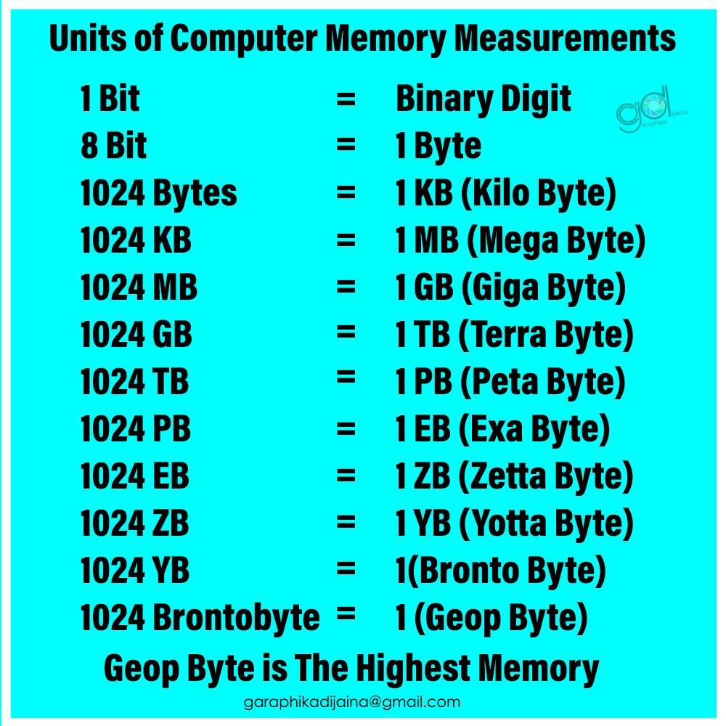

Slide 10
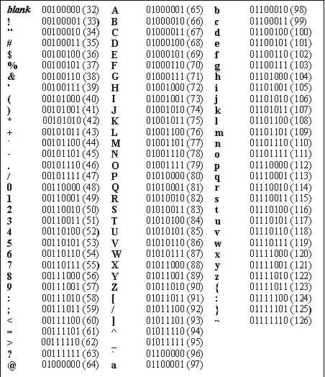
ASCII Table containing all printable characters

Slide 11
Two types of Storage Units:-
1. Primary Memory :-
Used to hold running program instructions.
Used to hold data, intermediate results, and results of ongoing processing of job(s).
Fast in operation
Small capacity
Expensive
Volatile(looses data on power dissipation)

Slide 12
Types of primary storage
RAM (Random Access Memory)
ROM (Read Only Memory)
CMOS (Complementary Metal Oxide Semiconductor Memory) – stores the system settings needed for the boot. This may include things like system date and time, first boot device, boot password, voltage power settings of RAM, etc.

Slide 13
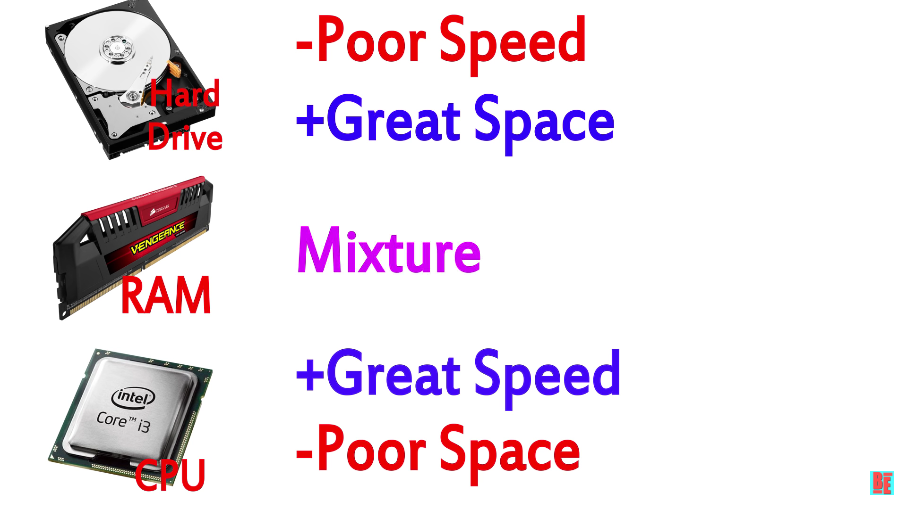

Slide 14
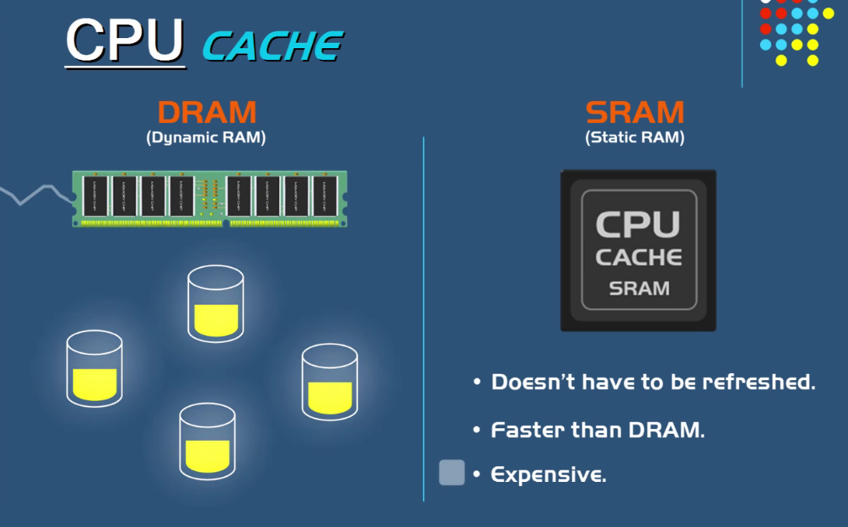
a. RAM
Random Access Memory (RAM):-
A random-access device allows stored data to be accessed directly in any random order.
Volatile in nature
Faster, smaller and expensive than secondary memory.
The two types of RAM :
a. Static RAM (SRAM),
b. Dynamic RAM (DRAM)

Slide 15
SRAM a bit of data is stored using the state of a flip-flop. This form of RAM is more expensive to produce, but is generally faster and requires less power than DRAM and, in modern computers, is often used as cache memory for the CPU.
DRAM stores a bit of data using a transistor and capacitor pair, which together comprise a memory cell. The capacitor holds a high or low charge (1 or 0, respectively), and the transistor acts as a switch that lets the control circuitry on the chip read the capacitor's state of charge or change it. As this form of memory is less expensive to produce than static RAM, it is the predominant form of computer memory used in modern computers.

Slide 16
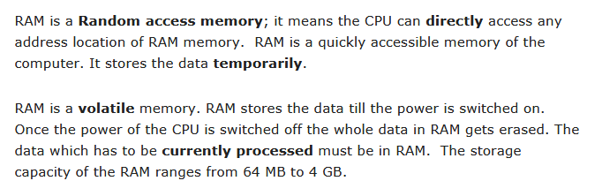
Random Access Memory

Slide 17
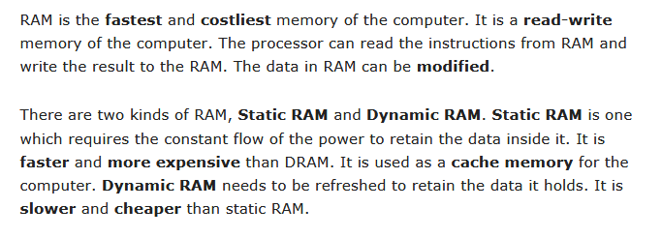

Slide 18
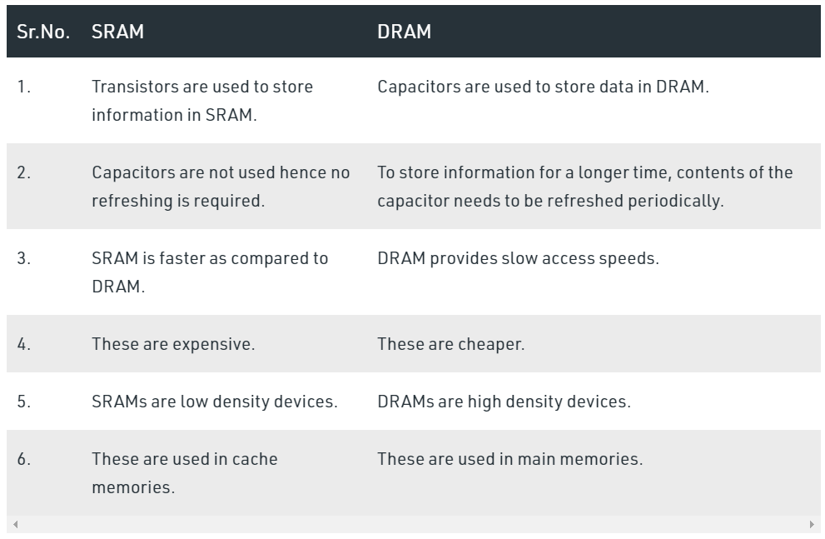

Slide 19
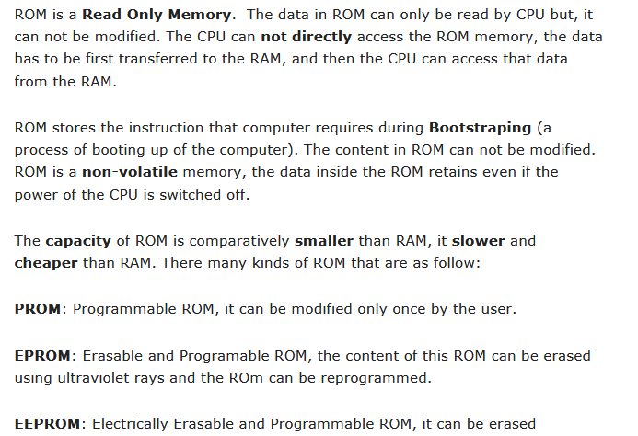
Read Only Memory

Slide 20
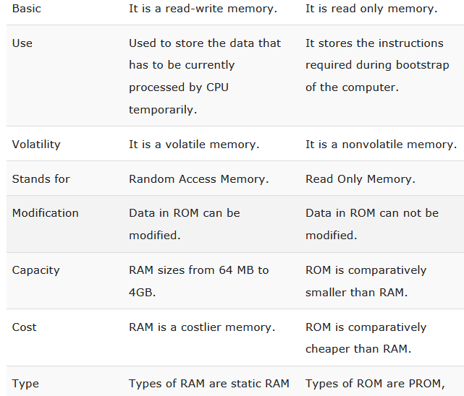
RAM VS ROM

Slide 21
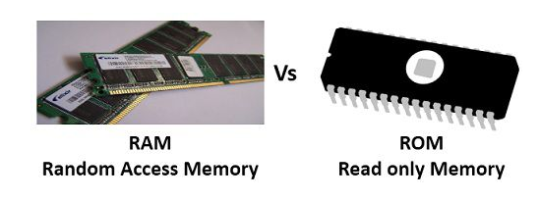

Slide 22
(c) CMOS
Complementary Metal Oxide Semiconductor (CMOS) memory is used to store the system configuration, date, time and other important data.
When computer is switched on, BIOS matches the information of CMOS with the peripheral devices and displays error in case of mismatching.

Slide 23
2. Secondary Storage :-
Used to hold program instructions
Used to hold data and information of stored jobs.
Slower than primary storage
Large capacity
Cheaper than primary storage
Nonvolatile in nature.
Example: HDD, CD-ROM, DVD, Pen drive, memory cards etc.

Slide 24
Primary vs Secondary memory
Primary
Smaller in size
Data is temporary
Primary is volatile memory
Data accessing is random
Data accessing is fast
It is expensive
Examples: RAM, ROM
Secondary
Larger in size
Data is permanent
Secondary memory is Non Volatile
Data sequential
Data accessing is slow
It is cheaper
Examples: HDD, CD, DVD, Memory card etc.

Slide 25
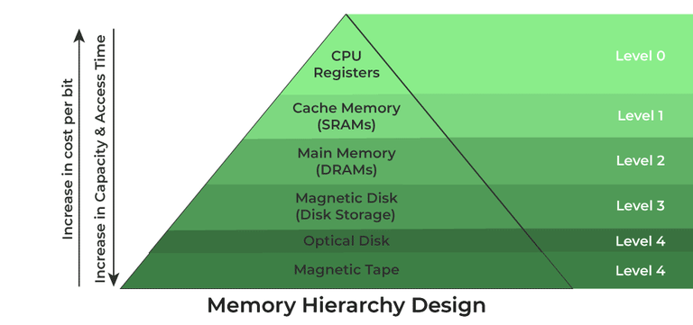

Slide 26
3. Input Unit
It accepts (or read) instructions and data from outside world.
It converts these instructions and data in computer acceptable form.
It supplies the converted instructions and data to the computer system for further processing.
Example of input device: Keyboard, Mouse, Scanner, etc.

Slide 27
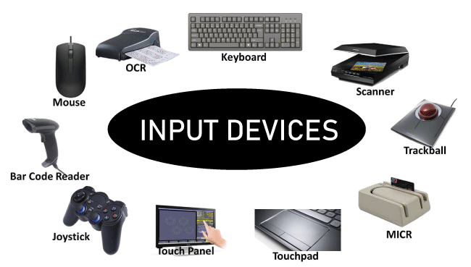

Slide 28
4. Output Unit
It accepts the results produced by the computer, which are in coded form and hence, cannot be easily understood by us.
It converts these coded results to human acceptable(readable) form.
It supplies the converted results to outside world.
Output Device: Monitor, Printer, Speaker, etc.

Slide 29
